Slide 1

Traffic Light Signal
Project
By Group 08

Slide 2

Team Members
Ifreet Zareef Hossain
23-53186-3
Masum Rahman Atul
23-54245-3
Rifat Intisar Zahin
23-54215-3
Raiyan Ahnaf
23-54227-3
Pranzit Datta
23-54225-3
Md. Zahid Hasan
23-54242-3

Slide 3
Table of contents
Introduction
Aims and Objectives
Components Required
Circuit Diagram
Working Process
Applications
Advantages
Limitations
Conclusion

Slide 4
Introduction
Traffic Lights are used to control the vehicular traffic. That’s why traffic lights are mandatory to avoid the traffic jams and accidents. There are three lights in the traffic signal, having different message for the drivers.
Red light asks the driver to yield at the intersection, green light gives the driver free license to drive through the intersection whereas the yellow light alerts the driver to wait if the next light is red one or get ready to go / turn the engine ON if the green light is next.

Slide 5
Aim and Objectives :
To simulate and analyze the performance of the proposed system under various traffic scenarios.
To implement the system using appropriate hardware and software components.
To analyze the effectiveness of the implemented system in reducing traffic congestion and minimizing wait times at intersections.
To improve road safety by minimizing the risk of accidents caused by human error or misjudgment.

Slide 6
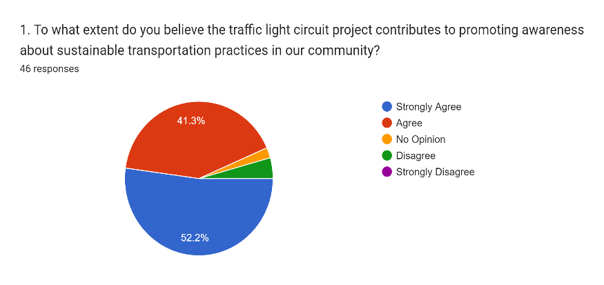
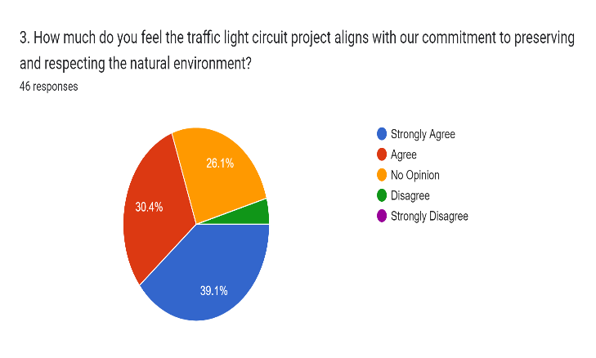
Survey:

Slide 7
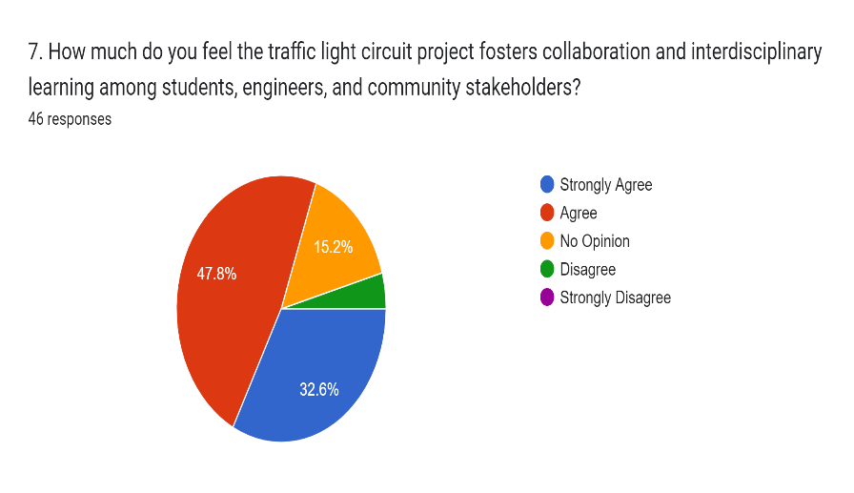
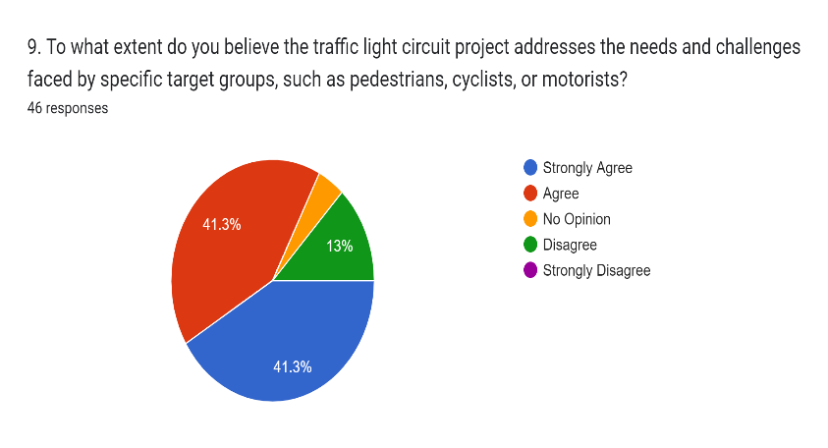
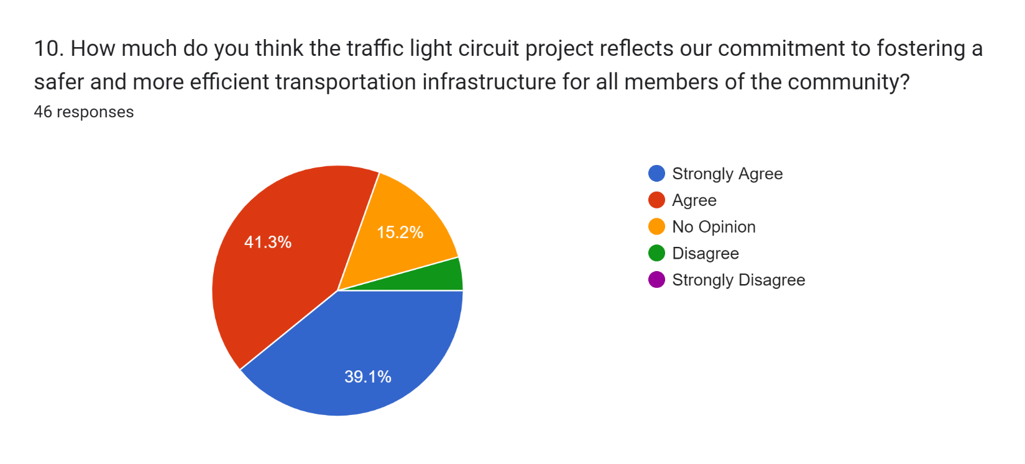
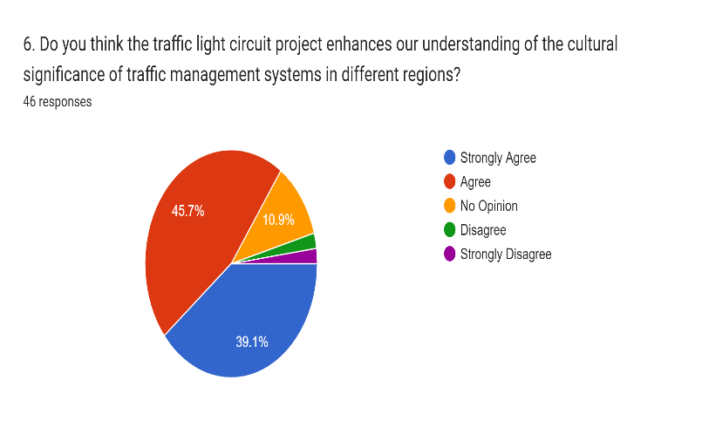

Slide 8
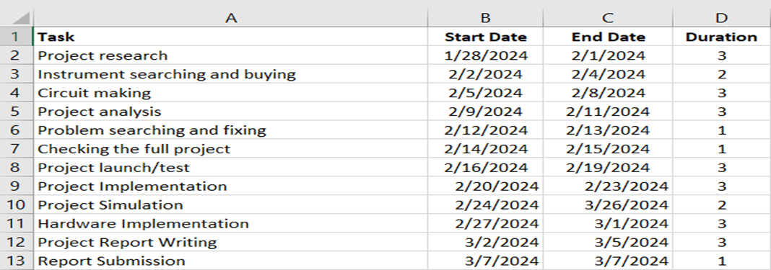
PROJECT TIMELINE (GANTT CHART):

Slide 9
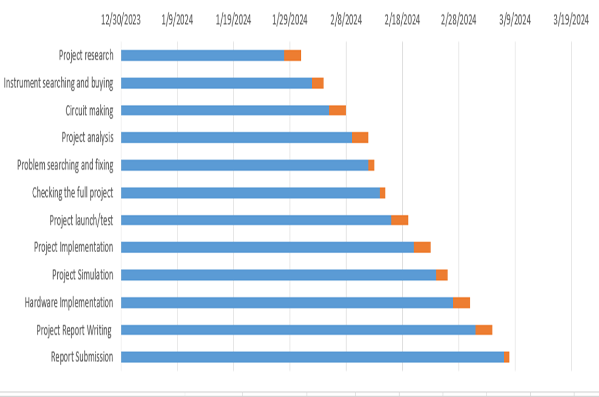

Slide 10
Components Required :
555 Timer IC 2x
100uf Capacitor 2x
100k Resistor
47k Resistor
390 Ohms Resistor 2x
33 Ohms Resistor
Breadboard
Connecting Wires

Slide 11
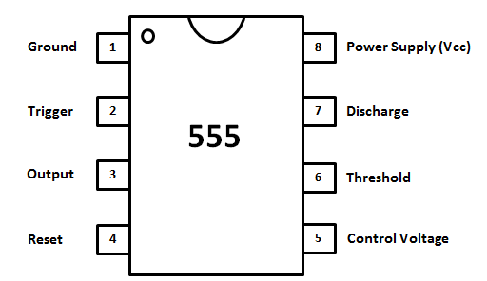
Pin Diagram of IC 555 :

Slide 12
Pin Description of IC 555 :
Pin 1 (Ground).
Pin 2 (Trigger).
Pin 3 (Output).
Pin 4 (Reset).
Pin 5 (Control).
Pin 6 (Threshold).
Pin 7 (Output).
Pin 8 (Supply).

Slide 13
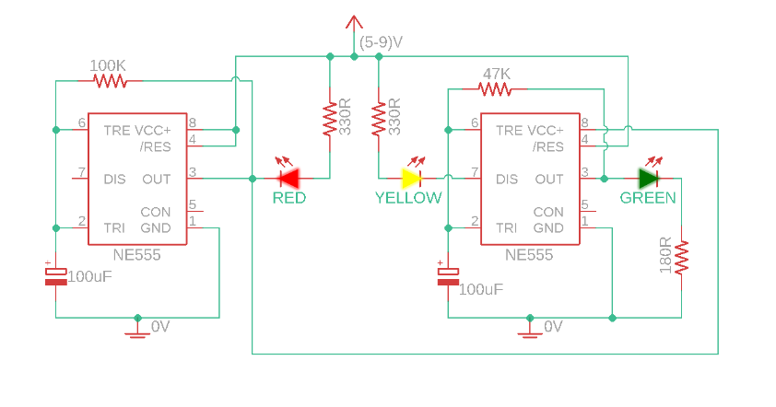
Circuit Diagram :

Slide 14
Working Process :
Red Light
The first 555 timer is configured in astable mode. The 100k resistor and 100uF capacitor on this timer determine the duration of the red light phase. When the circuit is powered on, the output of the first 555 timer is initially high, turning on the red LED through the 330 Ohm resistor.
Yellow Light
The second 555 timer is also configured in astable mode. The 47k resistor and 100uF capacitor on this timer determine the duration of the yellow light phase. When the capacitor of the first 555 timer reaches a specific voltage level, its output goes low, turning off the red LED. This triggers the second 555 timer, turning on the yellow LED through one of the 390 Ohm resistors.

Slide 15
Working Process :
Green Light
As the capacitor of the second 555 timer charges, its output eventually goes high.
This turns on the green LED through the other 390 Ohm resistor.
Cycle Repeats :
The process repeats continuously, with the red, yellow, and green lights turning on and off in sequence based on the timing set by the resistors and capacitors.

Slide 16
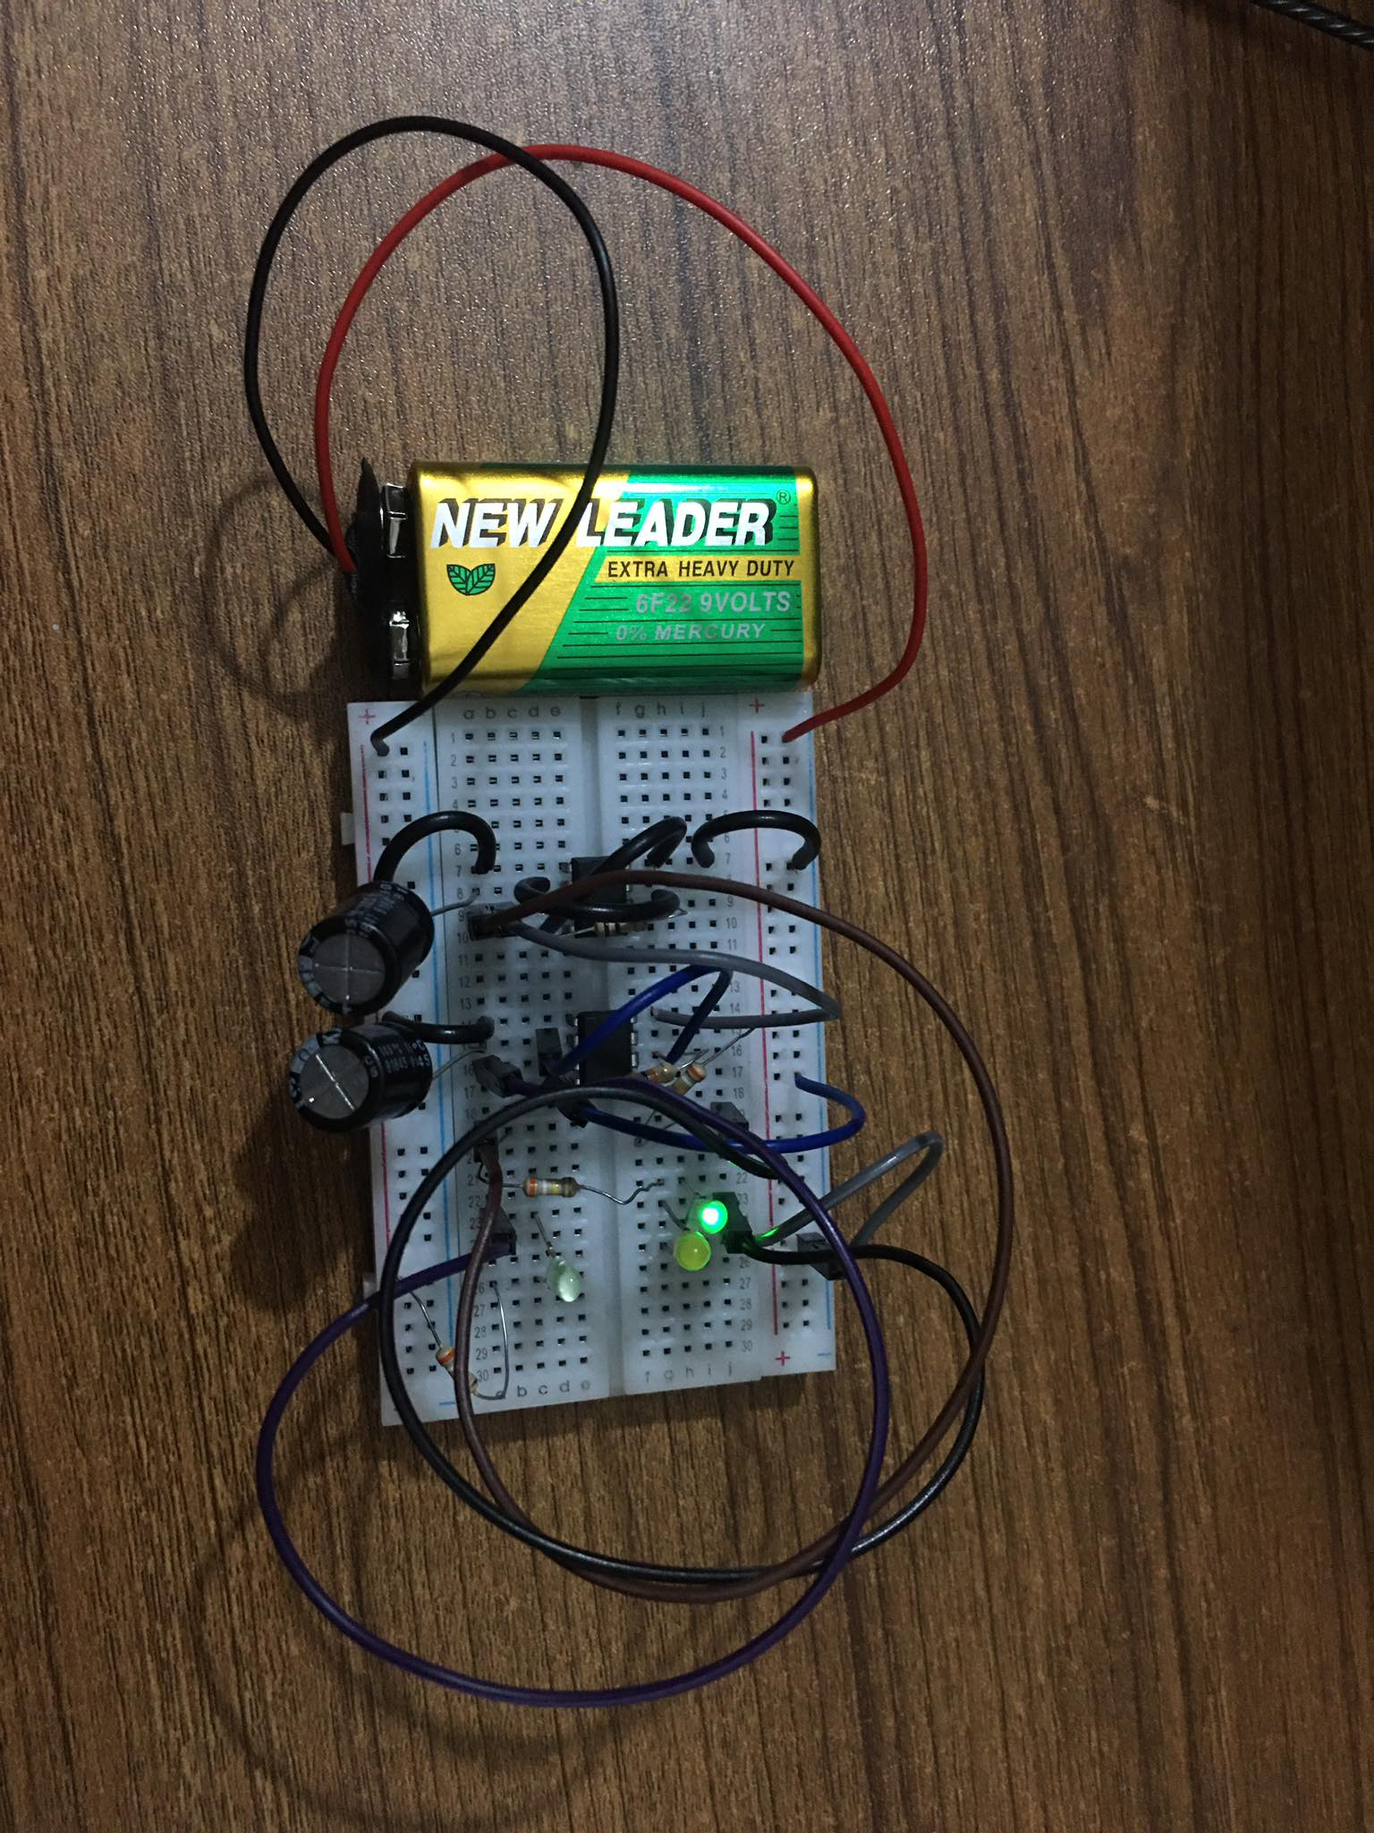

Slide 17
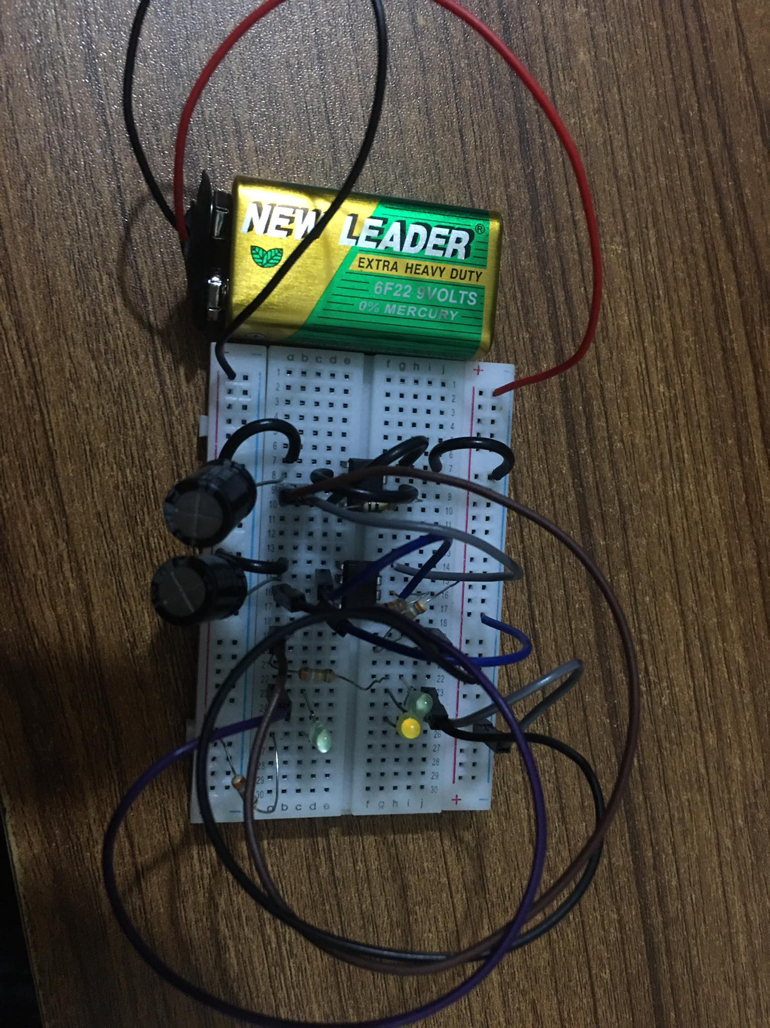

Slide 18
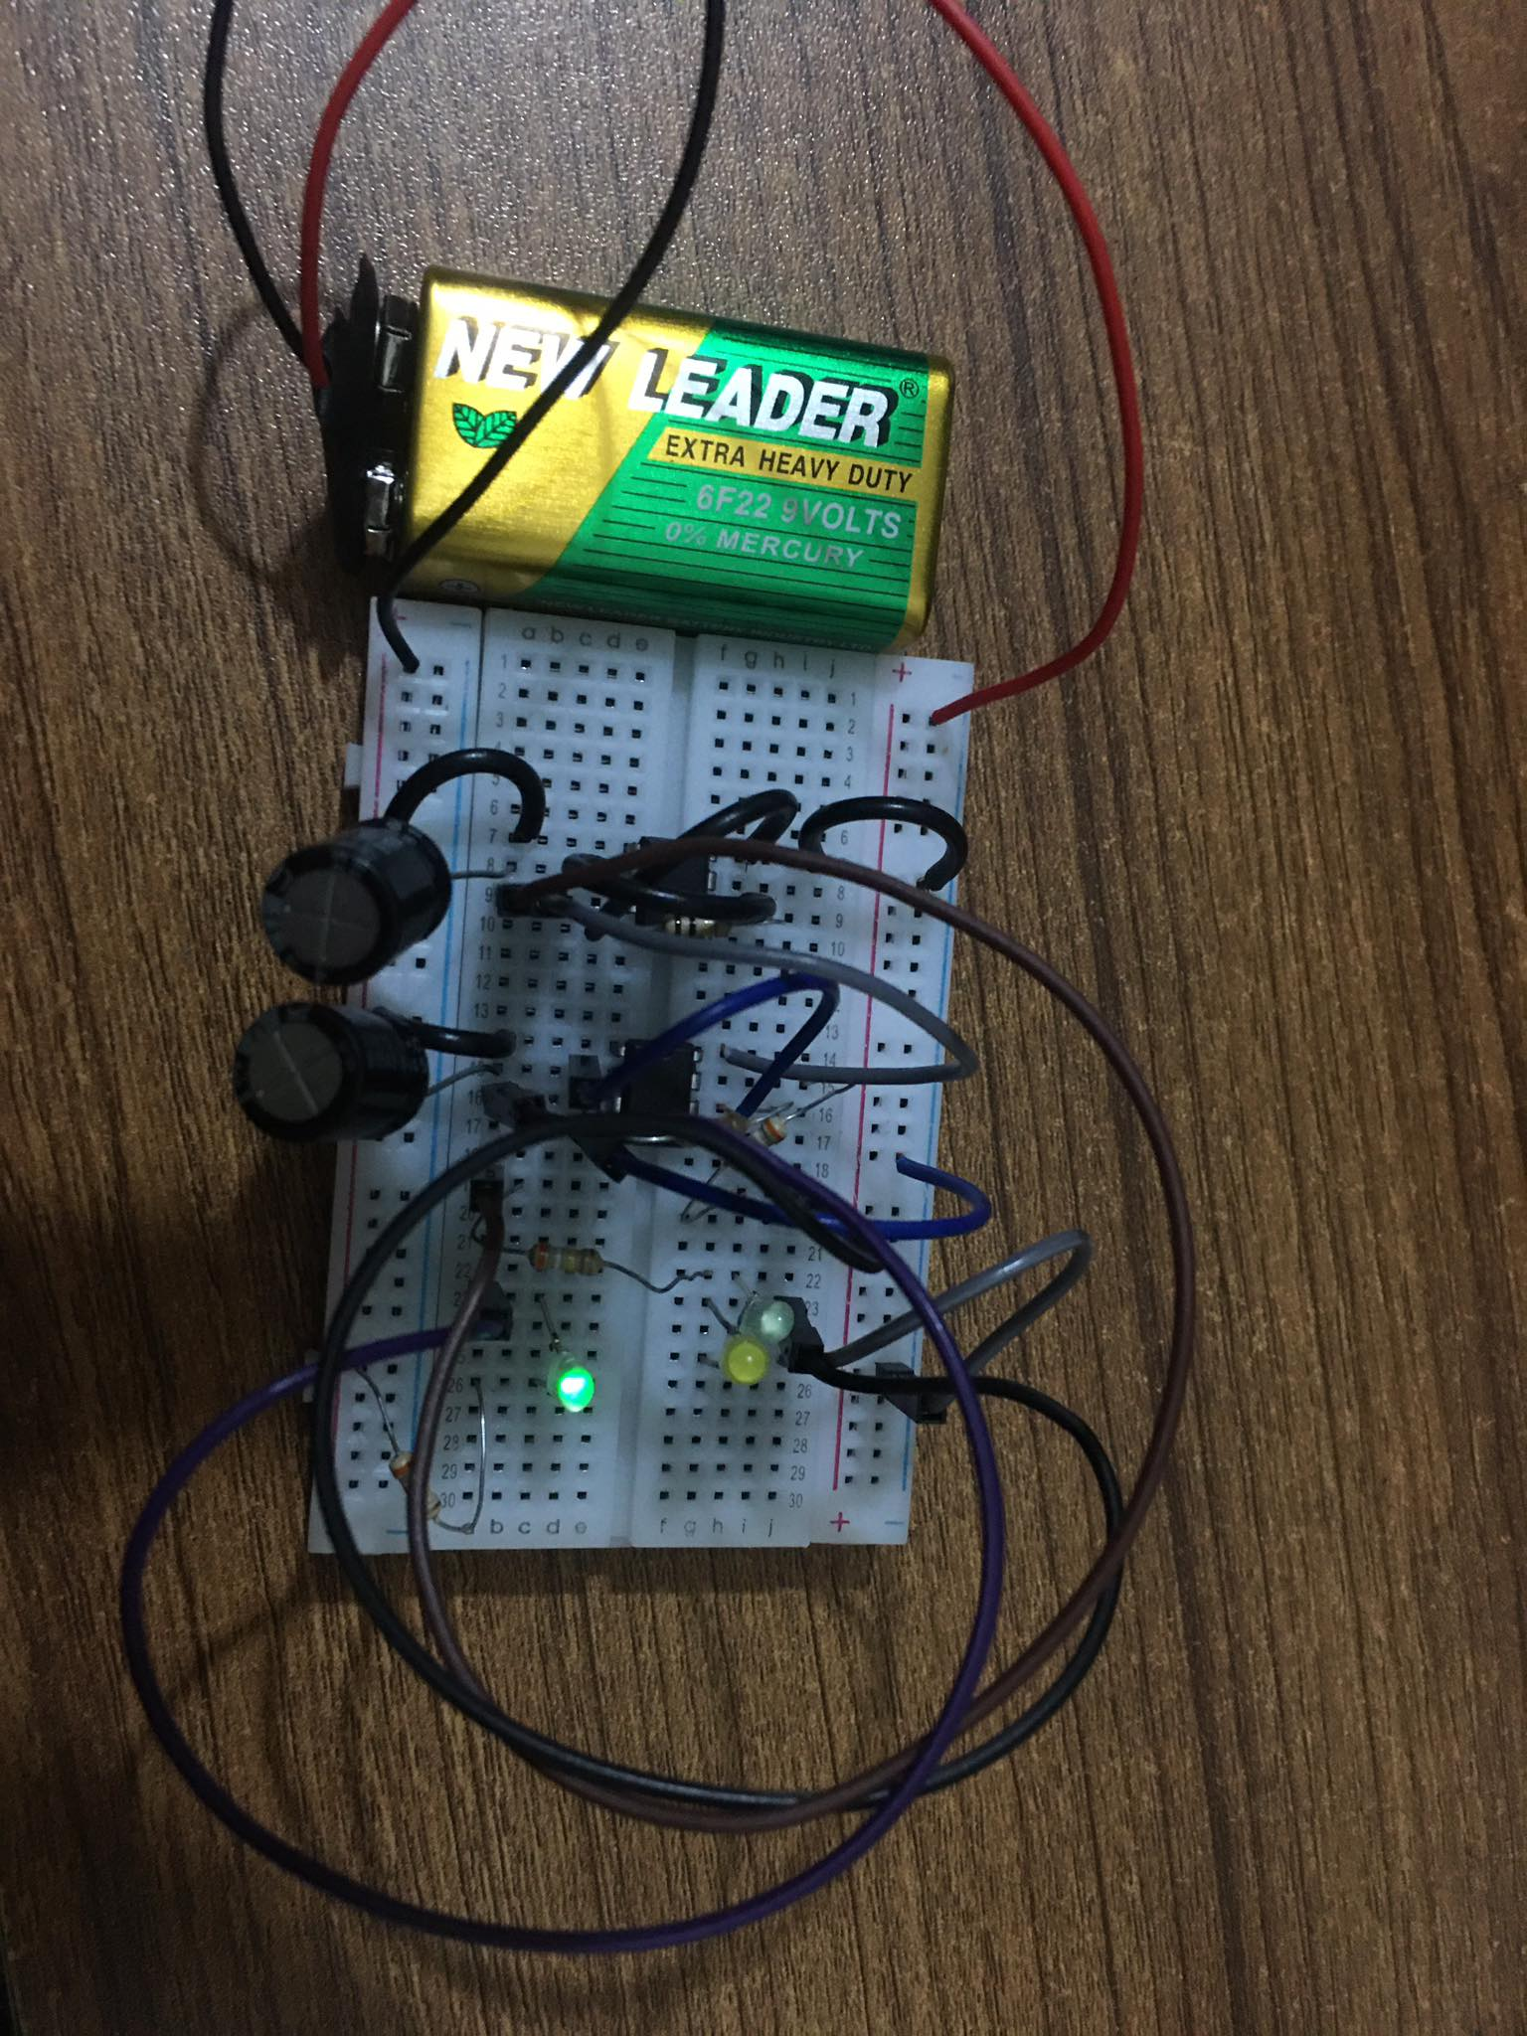

Slide 19
Applications :
Ramp metering.
Timers.
Fire station or Medical emergency entrance.
At the entrance and exit of some car washes.
At the landing-stage of a ferry and abroad the ferry.

Slide 20
Advantages :
Reduce fuel consumption.
Improve traffic guidance and traffic flow.
Increase safety.
Less cost.

Slide 21
Limitations :
Excessive delay may be caused.
Disobedience of signals.
The unnecessary delay results in significant fuel waste and higher motorist cost.

Slide 22

Conclusion :
We can increase the efficiency by using microprocessors (8086).
We can use this as remote traffic controller.

